Slide 1
Assignment :- create azure storage account using azure portal and azure cli ,upload file in storage account ,access it

Slide 2
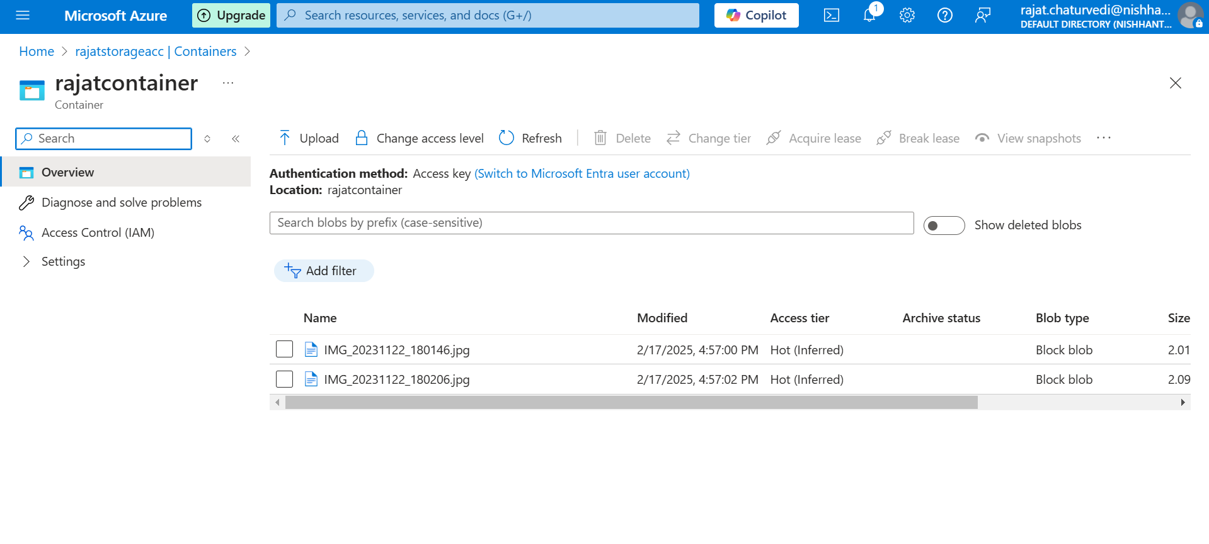
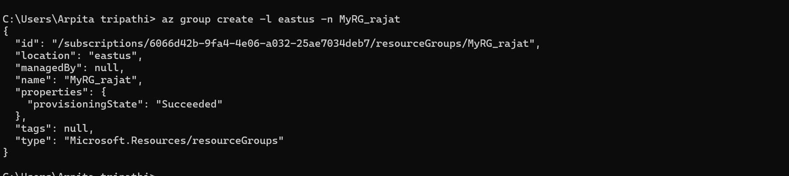
Create Storage and container account using Portal and upload the file in storage account

Slide 3
Create resource group(MyRG_rajat) using Azure CLI
command - az group create -l (location) -n (Resource_group name)

Slide 4
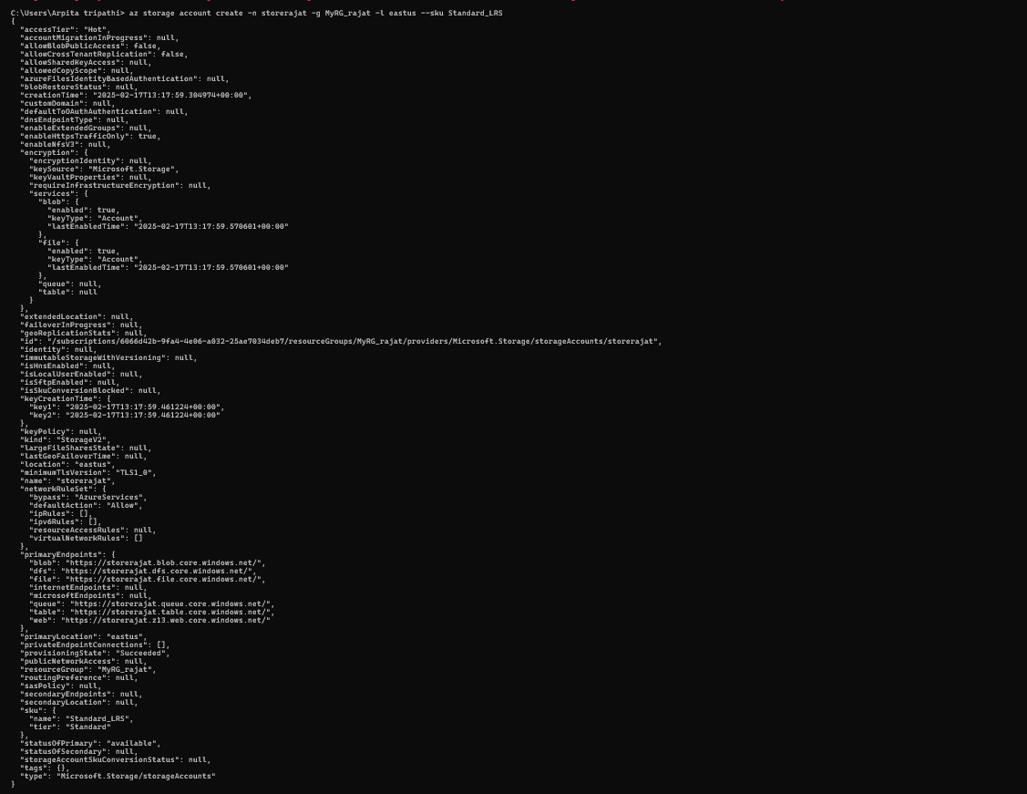
Create storage account (storerajat) using Azure CLI
Command - az storage account -n (storage_accountname) -g (resourcegroup_name) -l (location) --sku standard_LRS

Slide 5
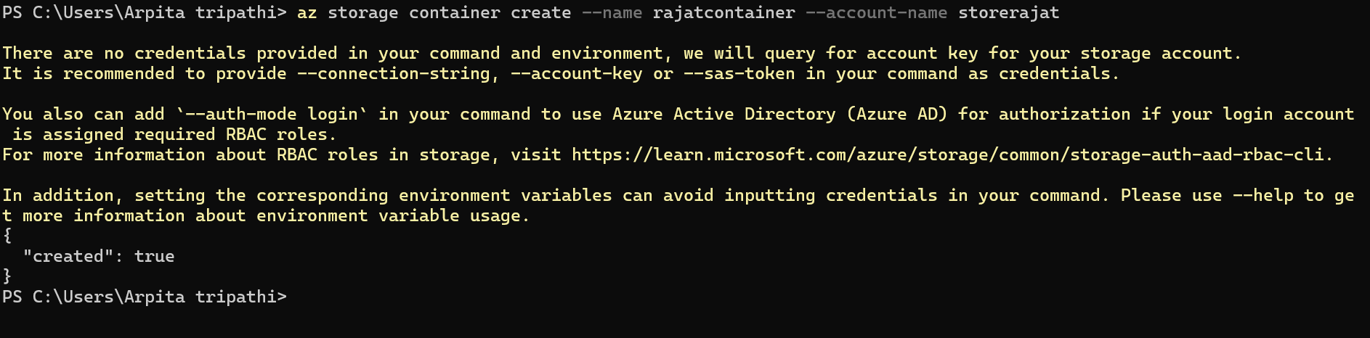
Create storage container (rajatcontainer) using Azure CLI
(command -az storage container create --name (container_name) --account-name (storageaccount_name)

